Slide 1
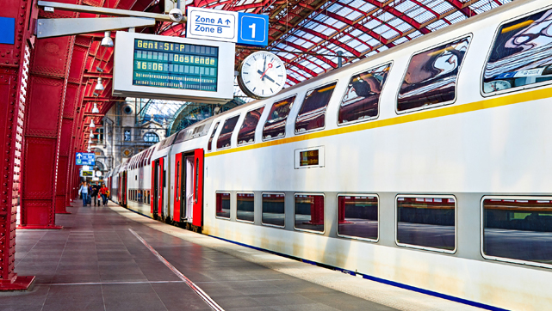
The Belgian Rail Revolution
SUNLENZ INDUSTRIES

Slide 2
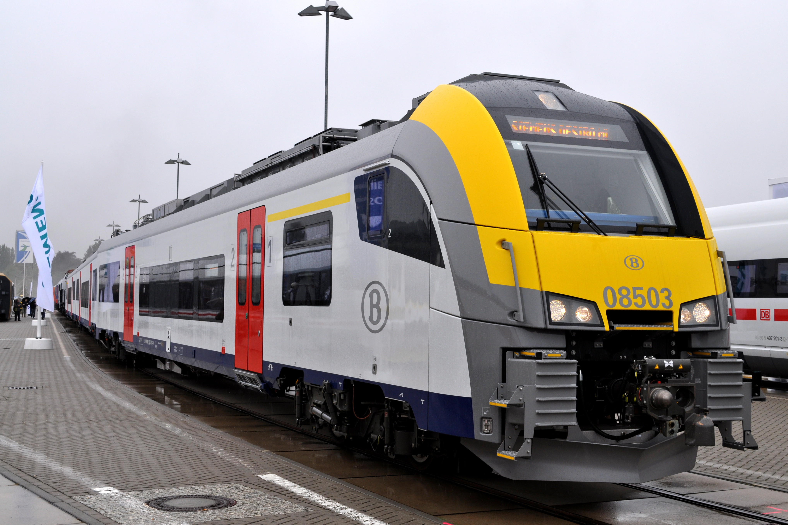
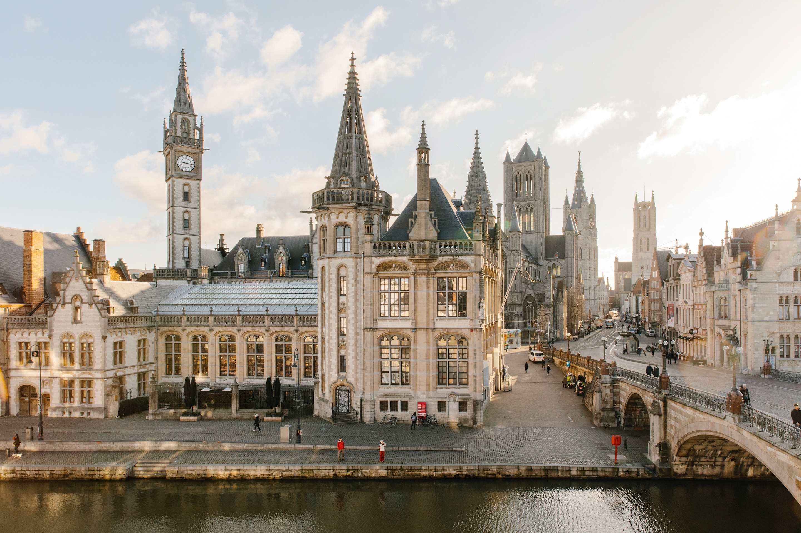

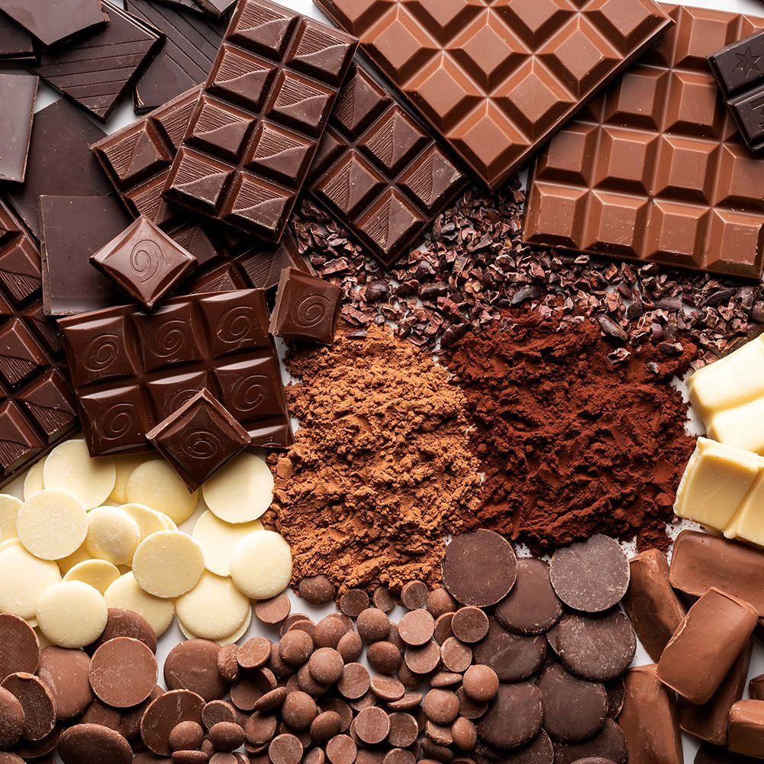
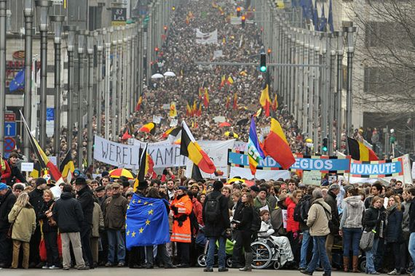
244,000,000 trips each year!

Slide 3
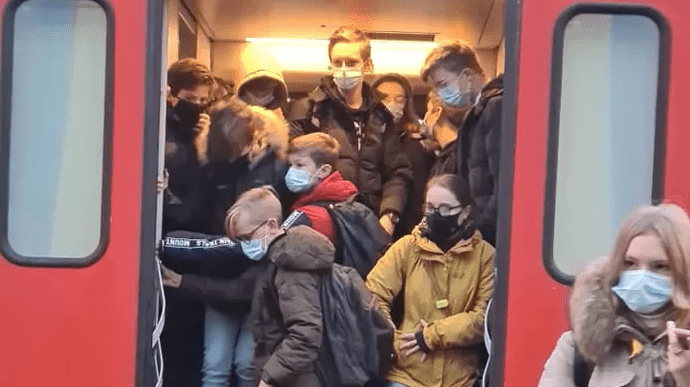
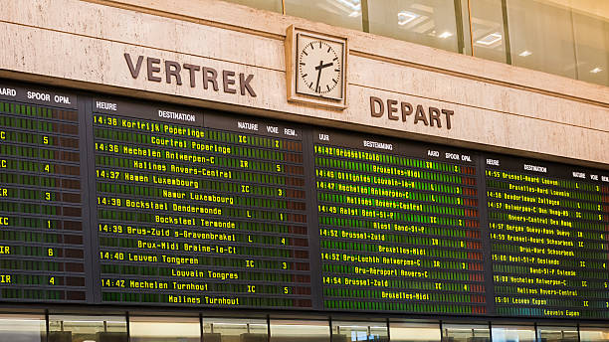
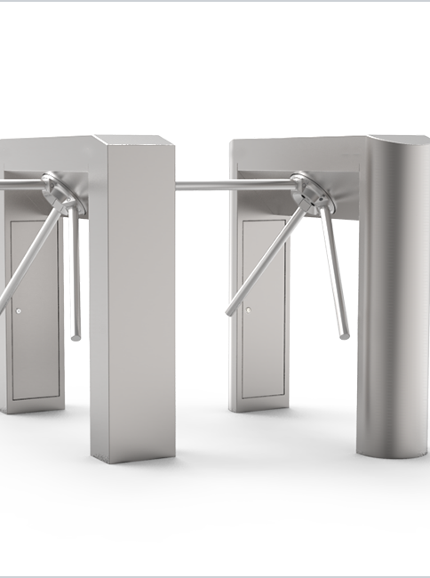

The Problem

Slide 4

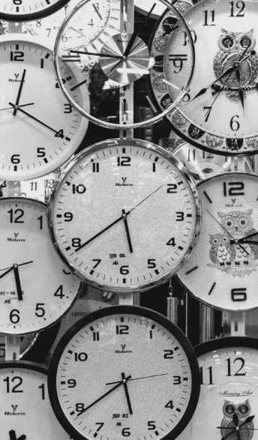


Slide 5

Introducing: SchedulRail!
SchedulRail
Please input schedule below
Line:
Date:
Train 1:
Time:
From:
To:
Train 2:
Time:
From:
To:
Train 3:
Time:
From:
To:
ADD TRAIN
GO!

Slide 6

Easy-to-use Interface!
SchedulRail
SchedulRail
SchedulRail
Welcome Niels!
Please input schedule below
Loading Results
Please Wait
Train 1:
Line:
Crowding
Risk
LOW
Date:
Train 1:
Time:
Train 2:
From:
To:
Crowding
Risk
HIGH
Train 2:
Time:
From:
Train 3:
To:
Train 3:
Crowding
Risk
LOW
Time:
From:
To:
ADD TRAIN
GO!
RESTART

Slide 7


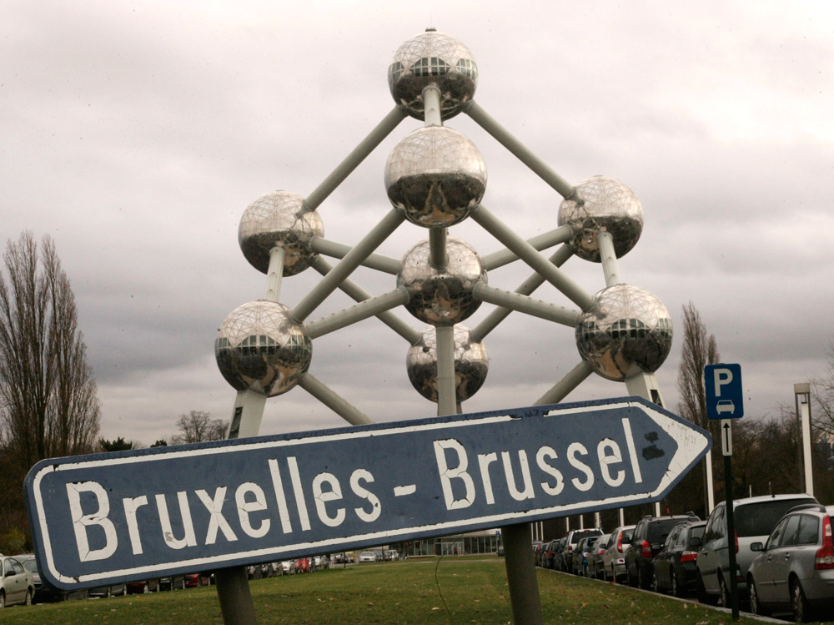
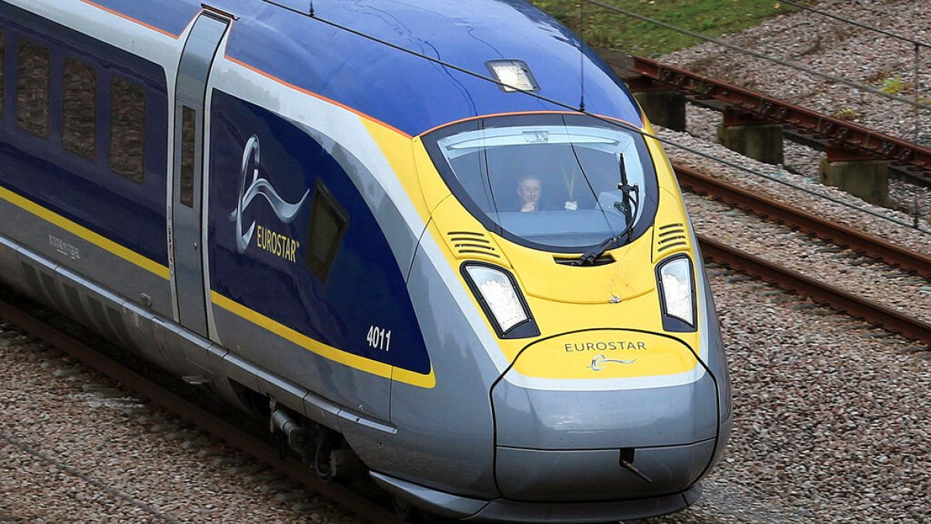
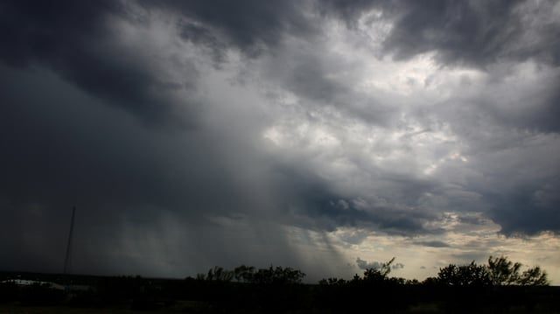

Slide 8
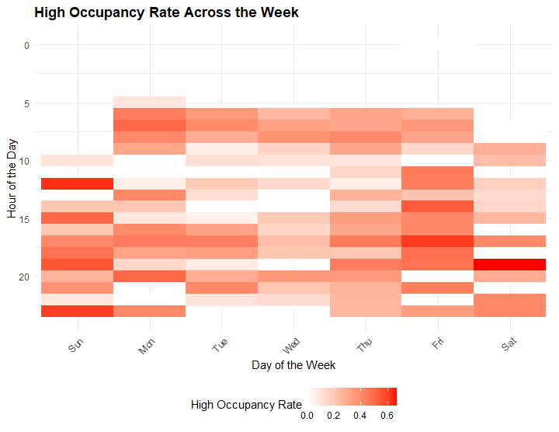
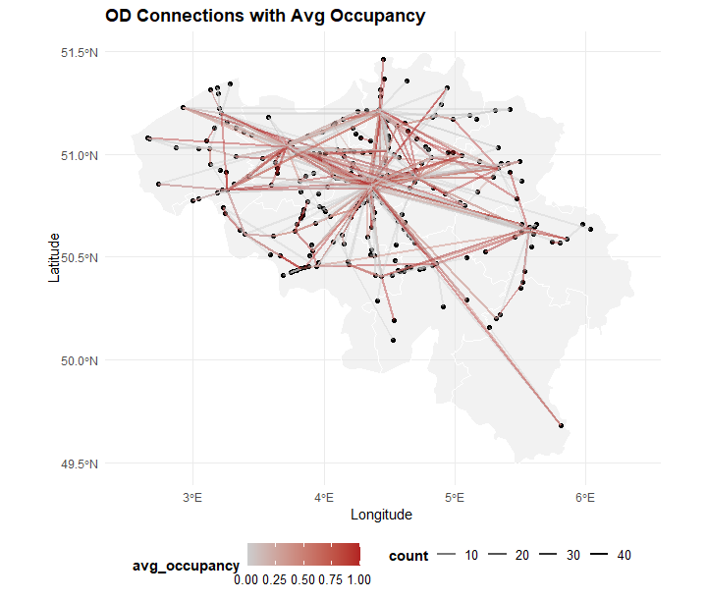
Good Data
MORNING RUSH
BRUSSELS
EVENING RUSH
SUNDAY TRAVEL
Useful Findings

Slide 9
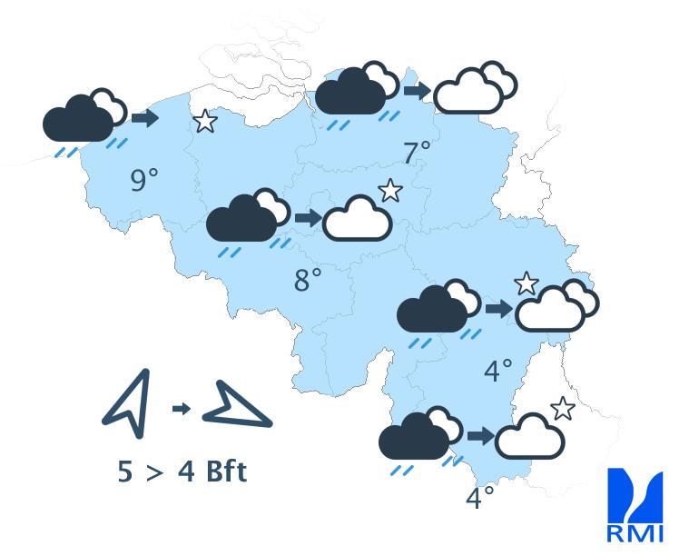
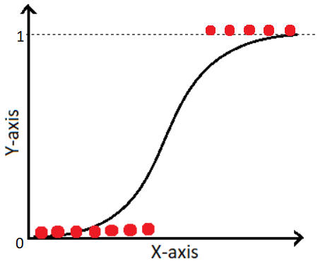

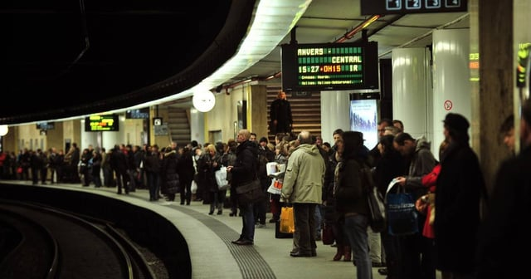
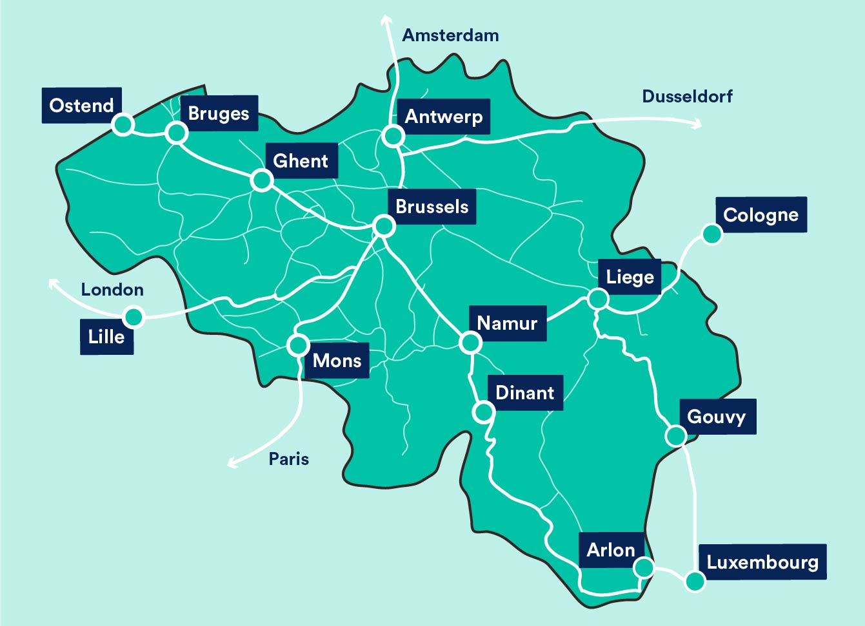
Goal: Predict High-Occupancy Trains

Slide 10

Feature Engineering
Day
Time
Day/Time Pair
Mon
9 AM
Mon/Morning
Station A
Station B
Origin/Destination Station Pair
Large Station
Medium
Station
Large/Large
Medium/Large

Slide 11

OCCUPANCY DATA
TEST
TRAINING
MODEL
EVALUATION
TEST
PREDICTION

Slide 12


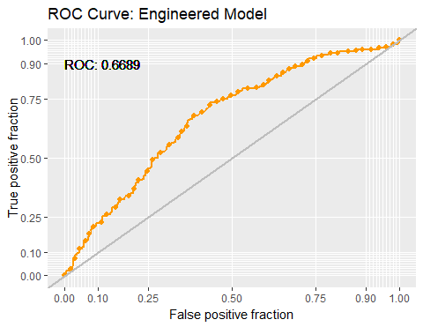
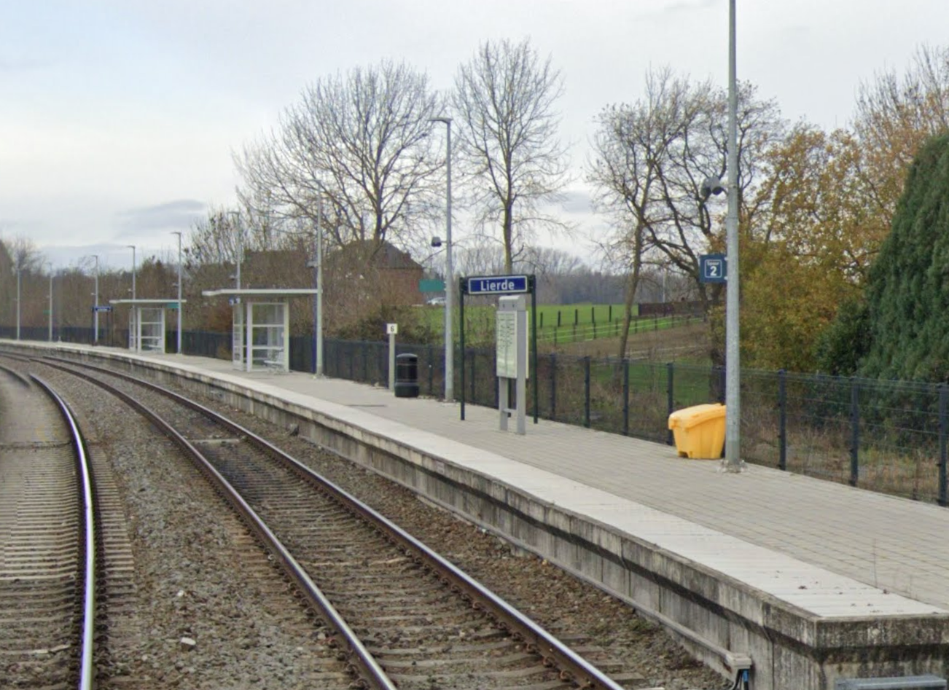
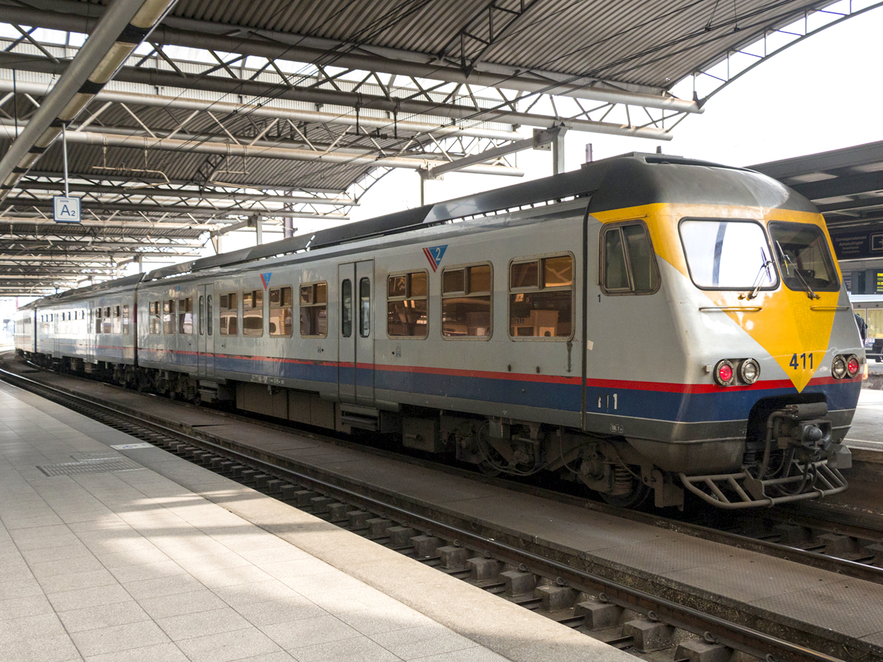
Early Model Results: Significant Factors
Mon/Noon, Tue/Noon
Sat/Morning, Sat/Noon
Accuracy | 0.66
Sensitivity | 0.40
Specificity | 0.78
Small/Medium Station Trips
Local, Special Trains

Slide 13
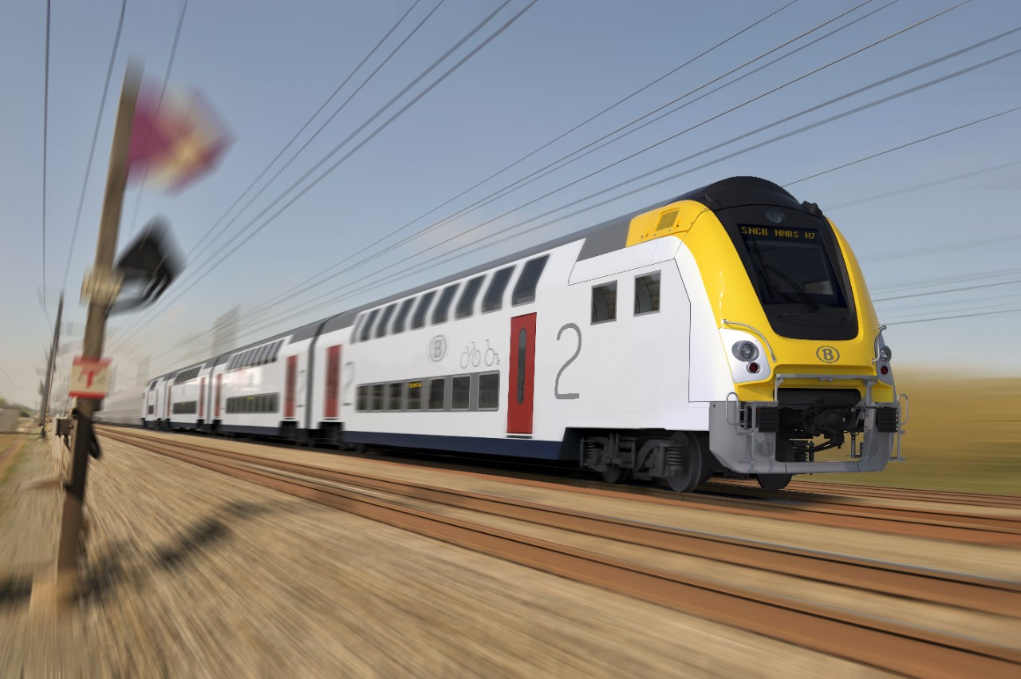

Future of Belgian Trains

